Slide 1

The Foundations of Artificial Intelligence
A Structured Study Guide for Students and Practitioners
This presentation provides a comprehensive overview of fundamental concepts in Artificial Intelligence, covering everything from core definitions and intelligent agents to complex search and constraint satisfaction problems. It is designed to serve as a high-level educational resource for those starting their journey in AI.

Slide 2

Part I: Defining Artificial Intelligence and Its Agents
What is AI and What are its Goals?
Artificial Intelligence (AI) is the science and engineering of making intelligent machines, especially intelligent computer programs. The field explores various goals:
Thinking Humanly
Cognitive Modeling: Understanding how human minds think and act.
Acting Humanly
Turing Test Approach: Creating machines that are indistinguishable from a human.
Thinking Rationally
Laws of Thought: Using formal logic to build intelligent systems.
Acting Rationally
Rational Agent Approach: Designing systems that act to achieve the best outcome.
The core of modern AI focuses primarily on the Rational Agent Approach.
The Turing Test
Proposed by Alan Turing in 1950, this test defines intelligent behavior as the ability of a machine to exhibit human-like behavior to the extent that an observer cannot distinguish it from a human.

Slide 3





The Rational Agent Framework
An AI system is often viewed as an Agent that perceives its environment through sensors and acts upon that environment through actuators. Central to rational action is Rationality: choosing the action that maximizes the expected value of the performance measure, given the percept sequence to date. Different agent designs achieve this rationality in various ways:
Simple Reflex Agent
Model-Based Agent
Goal-Based Agent
Utility-Based Agent
Reacts directly to its current percept, ignoring history (e.g., a thermostat).
Maintains an internal state of the world to track unobserved aspects of the environment.
Uses goal information to select actions that lead to a desirable future state.
Selects actions that maximize expected utility, crucial when goals conflict or uncertainty exists.
Learning Agent
Adapts and improves performance based on experience, continuously enhancing its capabilities.

Slide 4




Deconstructing the Learning Agent
A learning agent consists of several distinct components that work together to enable continuous improvement and adaptation.
Learning Element
Critic
Performance Element
Problem Generator
This component is responsible for making improvements, utilizing feedback from the Critic and new experiences generated by the Problem Generator to enhance the agent's capabilities.
The Critic evaluates the agent's performance against a fixed standard, providing crucial feedback on how well actions align with desired outcomes.
This is the part of the agent that selects and executes external actions in the environment, representing the agent's direct interaction with the world.
Suggests new, exploratory actions to the Performance Element, encouraging the agent to discover novel and potentially more optimal strategies through varied experiences.

Slide 5


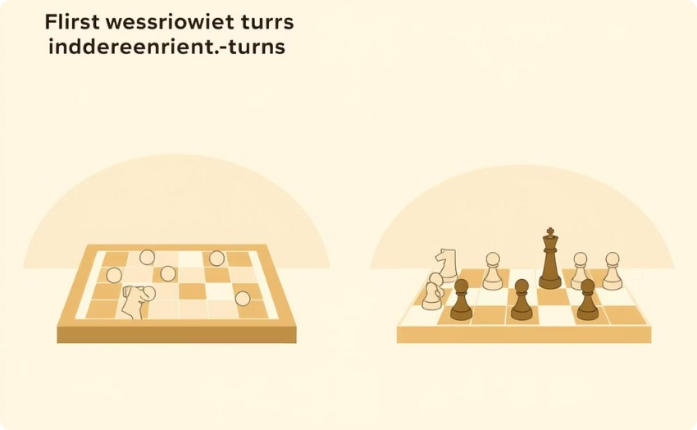




Characterizing the Environment
The characteristics of the environment significantly influence the complexity of the agent required. Environments are classified across several dimensions.
Observability
Determinism
Episodic Nature
Agent Count
Fully Observable (The agent's sensors give it access to the complete state of the environment) vs. Partially Observable (Some aspects are hidden).
Deterministic (The next state is completely determined by the current state and the agent's action) vs. Stochastic (Randomness and uncertainty involved).
Episodic (Agent's experience is divided into separate episodes, where the choice in one episode doesn't affect the next) vs. Sequential (Current action affects all future decisions).
Single Agent (One agent operating alone) vs. Multi-Agent (Multiple agents interacting and competing).
Change
Structure
Knowledge
Static (Environment does not change while the agent is deliberating) vs. Dynamic (Environment can change).
Discrete (Finite number of distinct percepts and actions) vs. Continuous (Infinite range of values, like in robotics).
Known (The agent understands the rules of the environment) vs. Unknown (The agent must learn how the environment works).

Slide 6

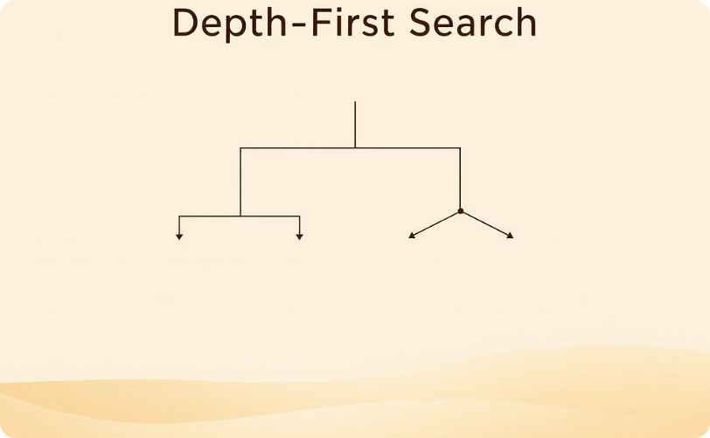
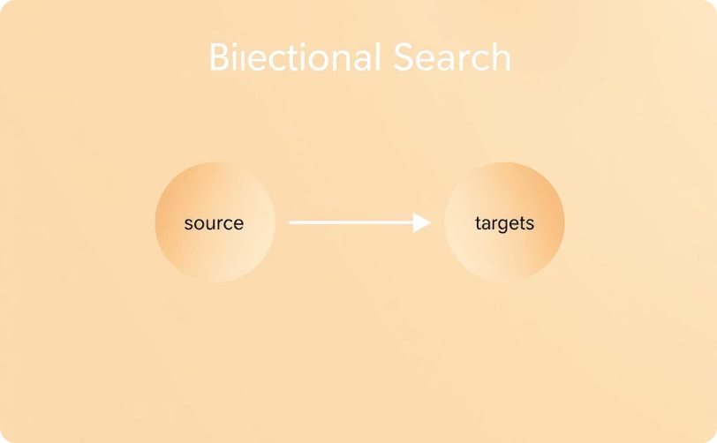
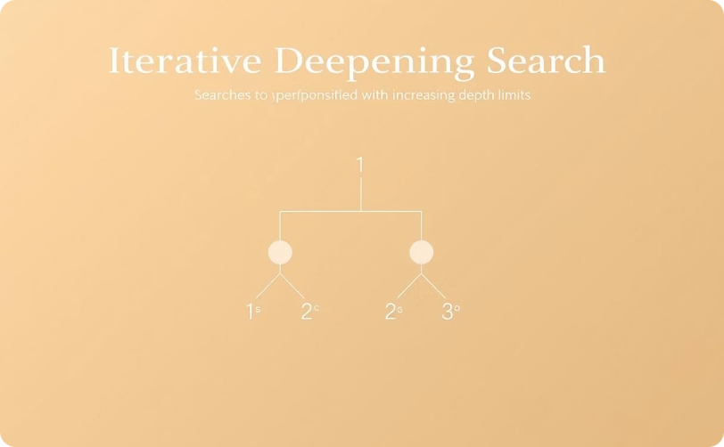
Part II: State Space Search and Uninformed Strategies
Search: Solving Well-Defined Problems
A well-defined problem must have four components: an initial state, a set of possible actions (successor function), a goal test (to check if a state is a goal), and a path cost function. State Space Search algorithms systematically explore the possible states to find a path from the initial state to a goal state.
Breadth-First Search (BFS)
Depth-First Search (DFS)
Bidirectional Search
Iterative Deepening Search (IDS)
Explores all nodes at the present depth level before moving to the nodes at the next depth level. It is complete (finds a solution if one exists) and optimal (finds the shallowest solution).
Explores as far as possible down each branch before backtracking. It is memory efficient but neither complete nor optimal for infinite or very deep spaces.
Runs two simultaneous searches, one forward from the initial state and one backward from the goal state, hoping they meet in the middle to reduce the search space drastically.
Combines DFS's space efficiency and BFS's completeness/optimality by repeatedly doing Depth-Limited Search (DLS) with increasing depth limits.

Slide 7
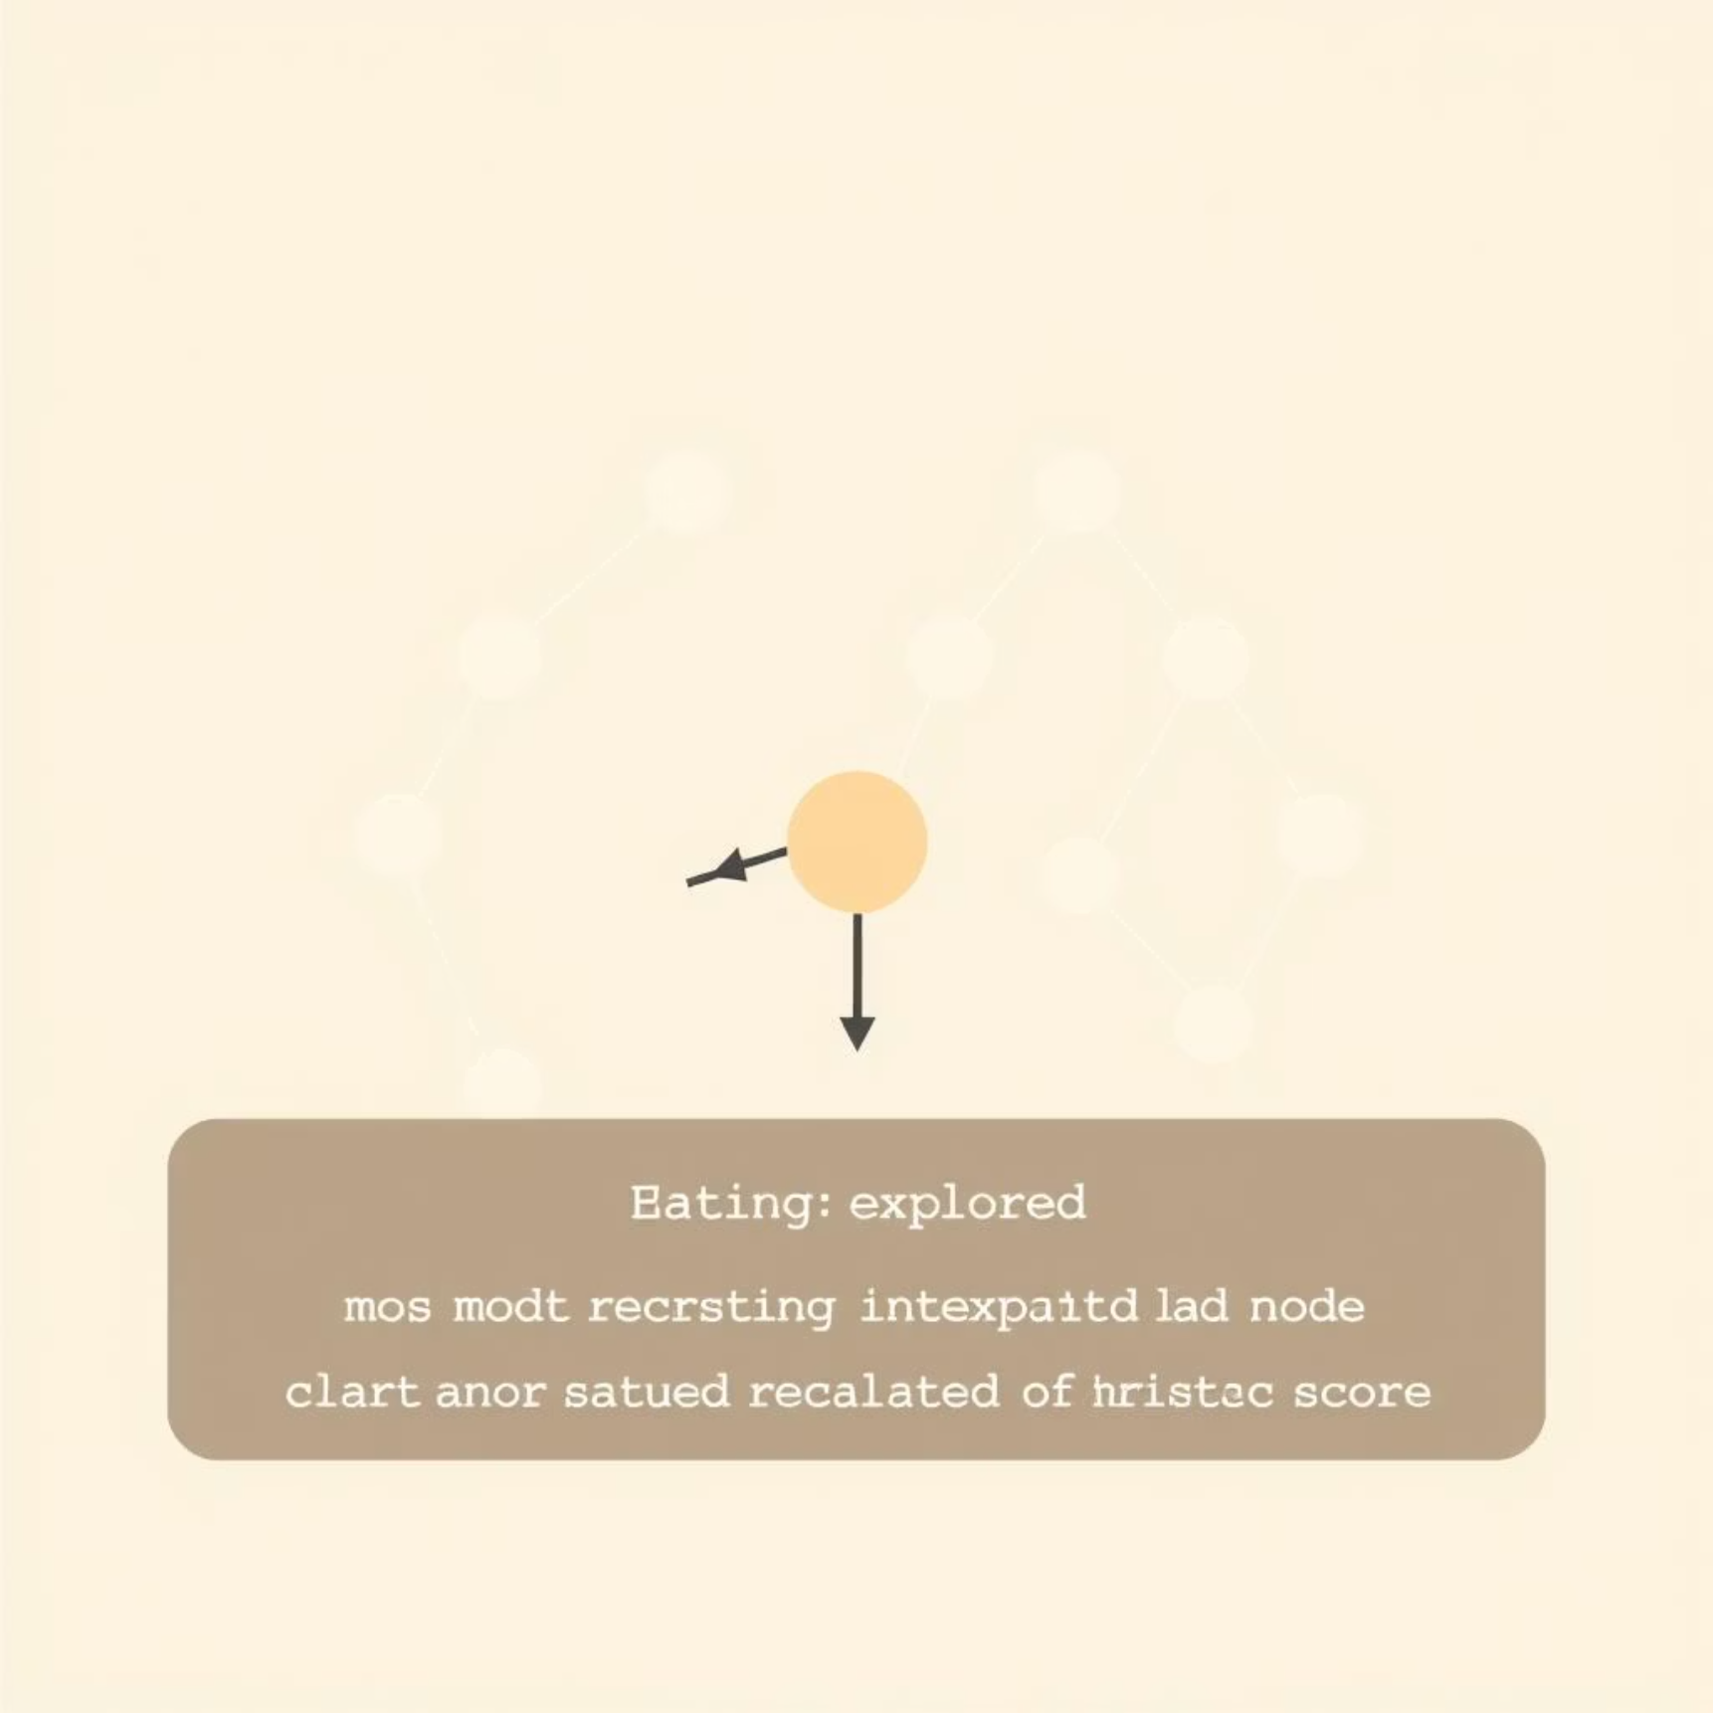


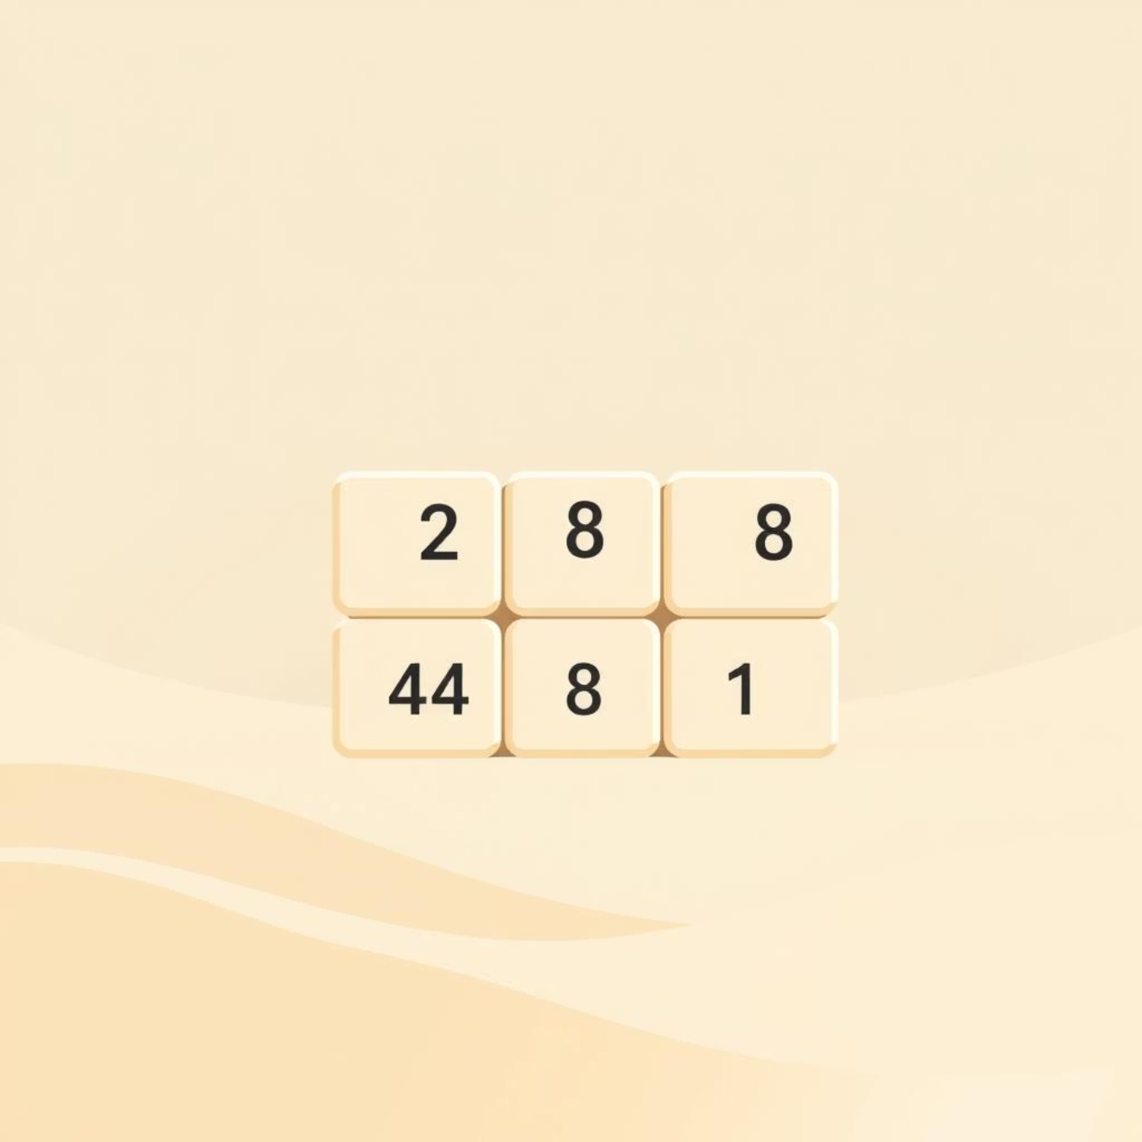
Informed Search: Using Heuristics
Informed search strategies use problem-specific knowledge, known as a heuristic, to guide the search and find solutions more efficiently than uninformed methods. A heuristic function $h(n)$ estimates the cost of the cheapest path from state $n$ to a goal state.
Best-First Search
Best-First Search: Uses the heuristic to select the best unexpanded node, often implemented as Greedy Best-First Search, which prioritizes nodes closest to the goal.
Hill Climbing
Hill Climbing: A local search algorithm that continuously moves in the direction of increasing value (uphill), stopping when it reaches a "peak" or local optimum.
Beam Search
Beam Search: A variant of Best-First Search that limits the number of states at any given level to a fixed size (k), restricting memory usage.
The 8-Puzzle and the N-Queen Problem are classic examples where heuristics, such as the number of misplaced tiles or Manhattan distance, dramatically improve performance over brute force methods.

Slide 8

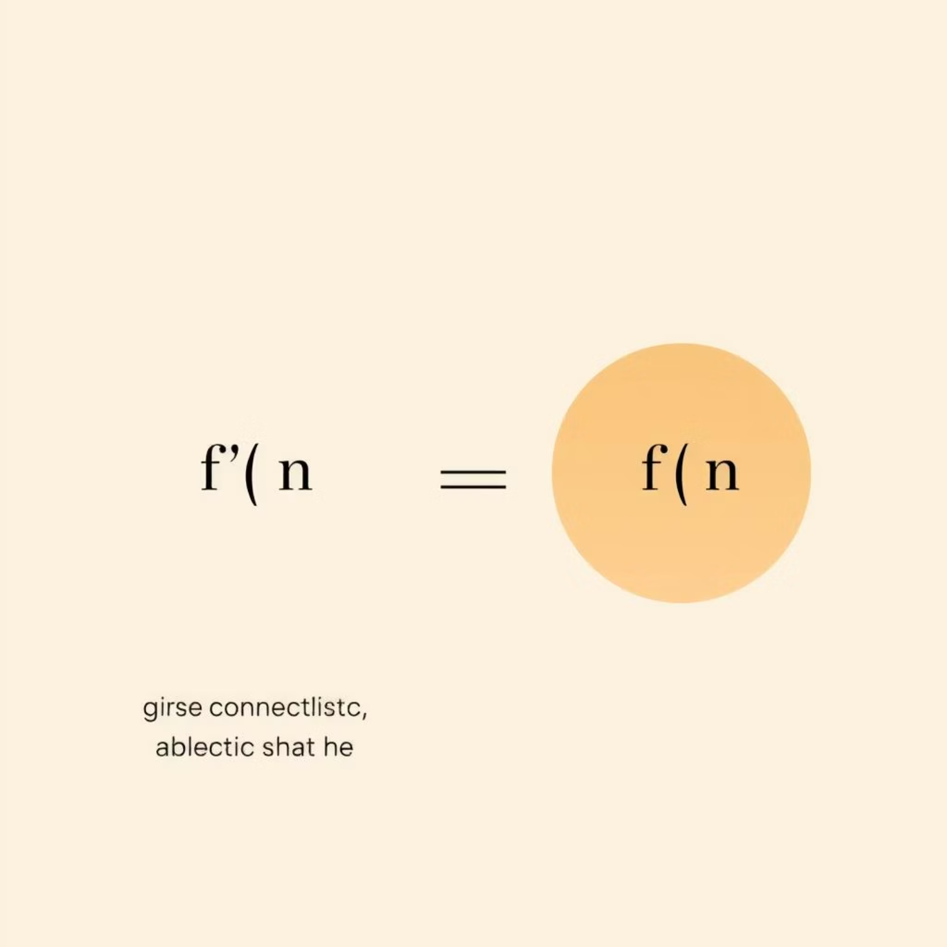
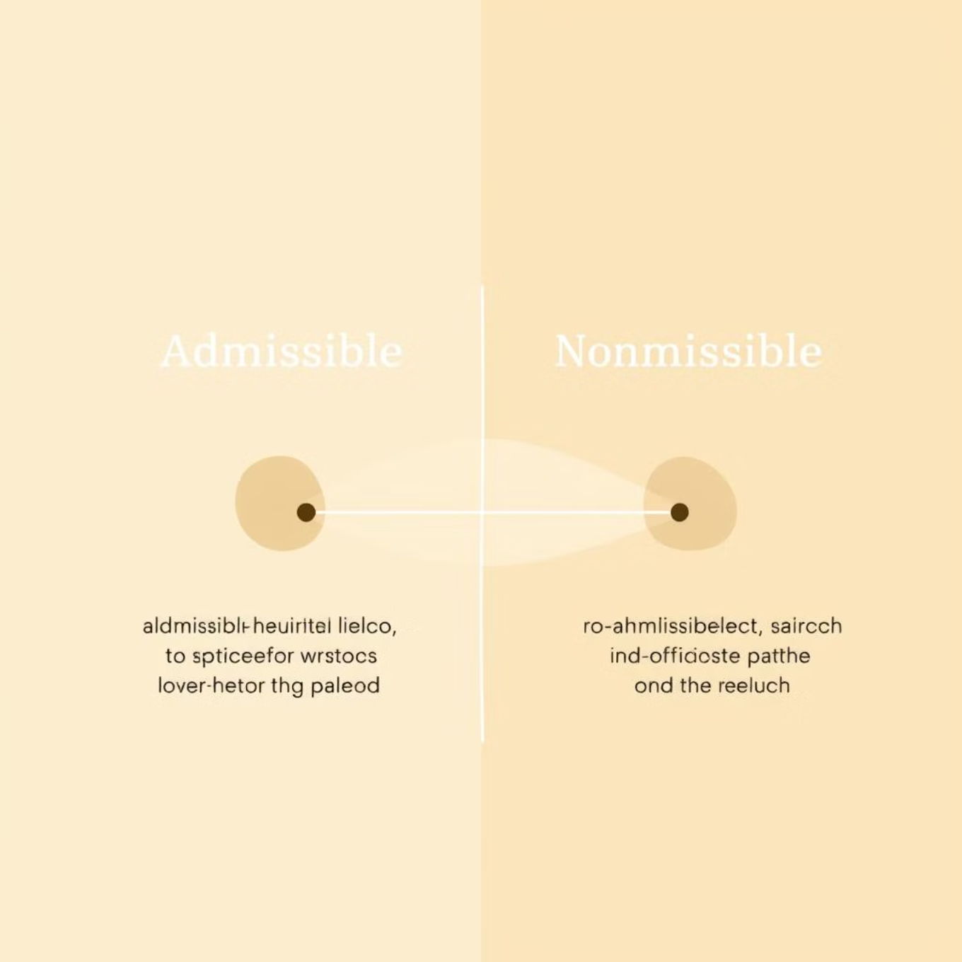
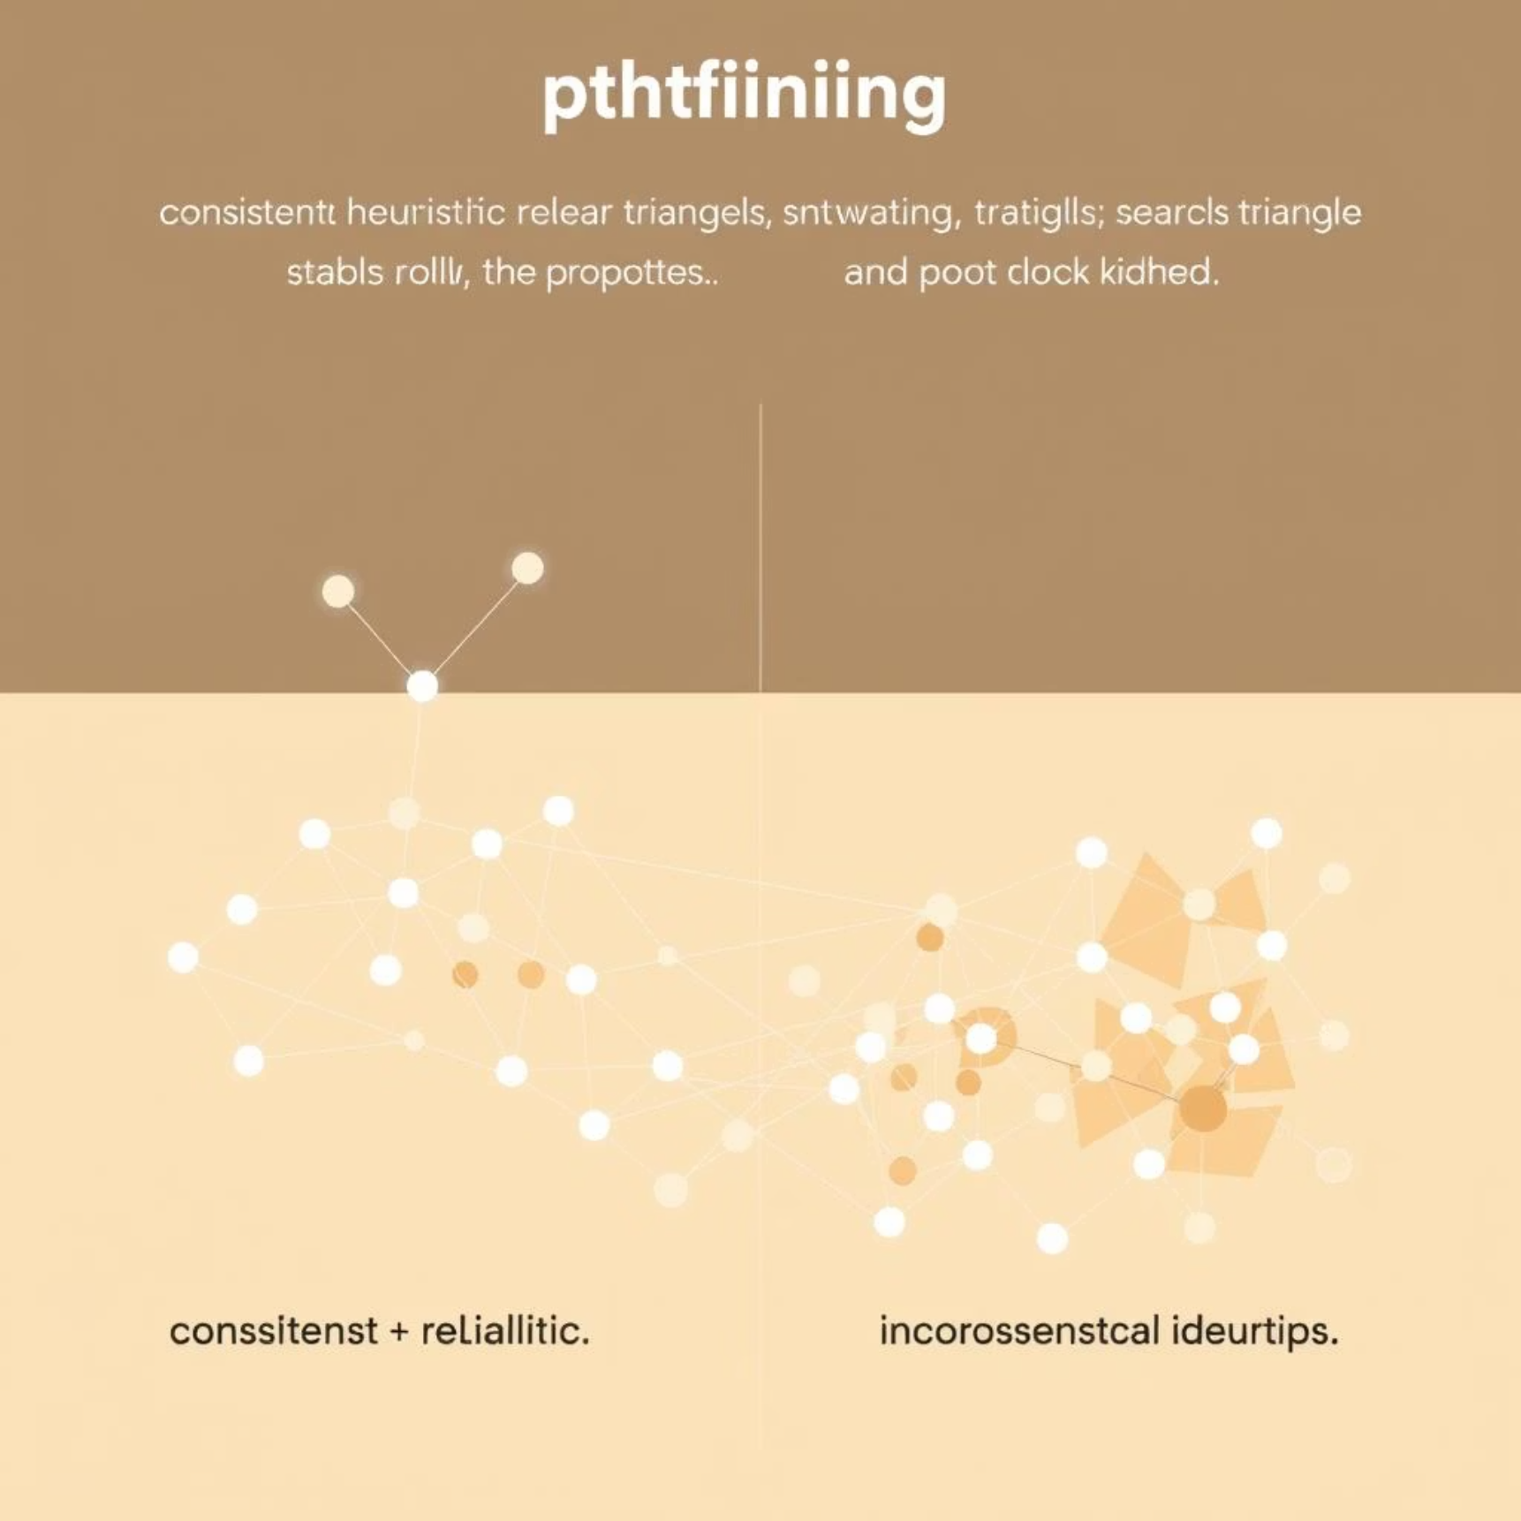


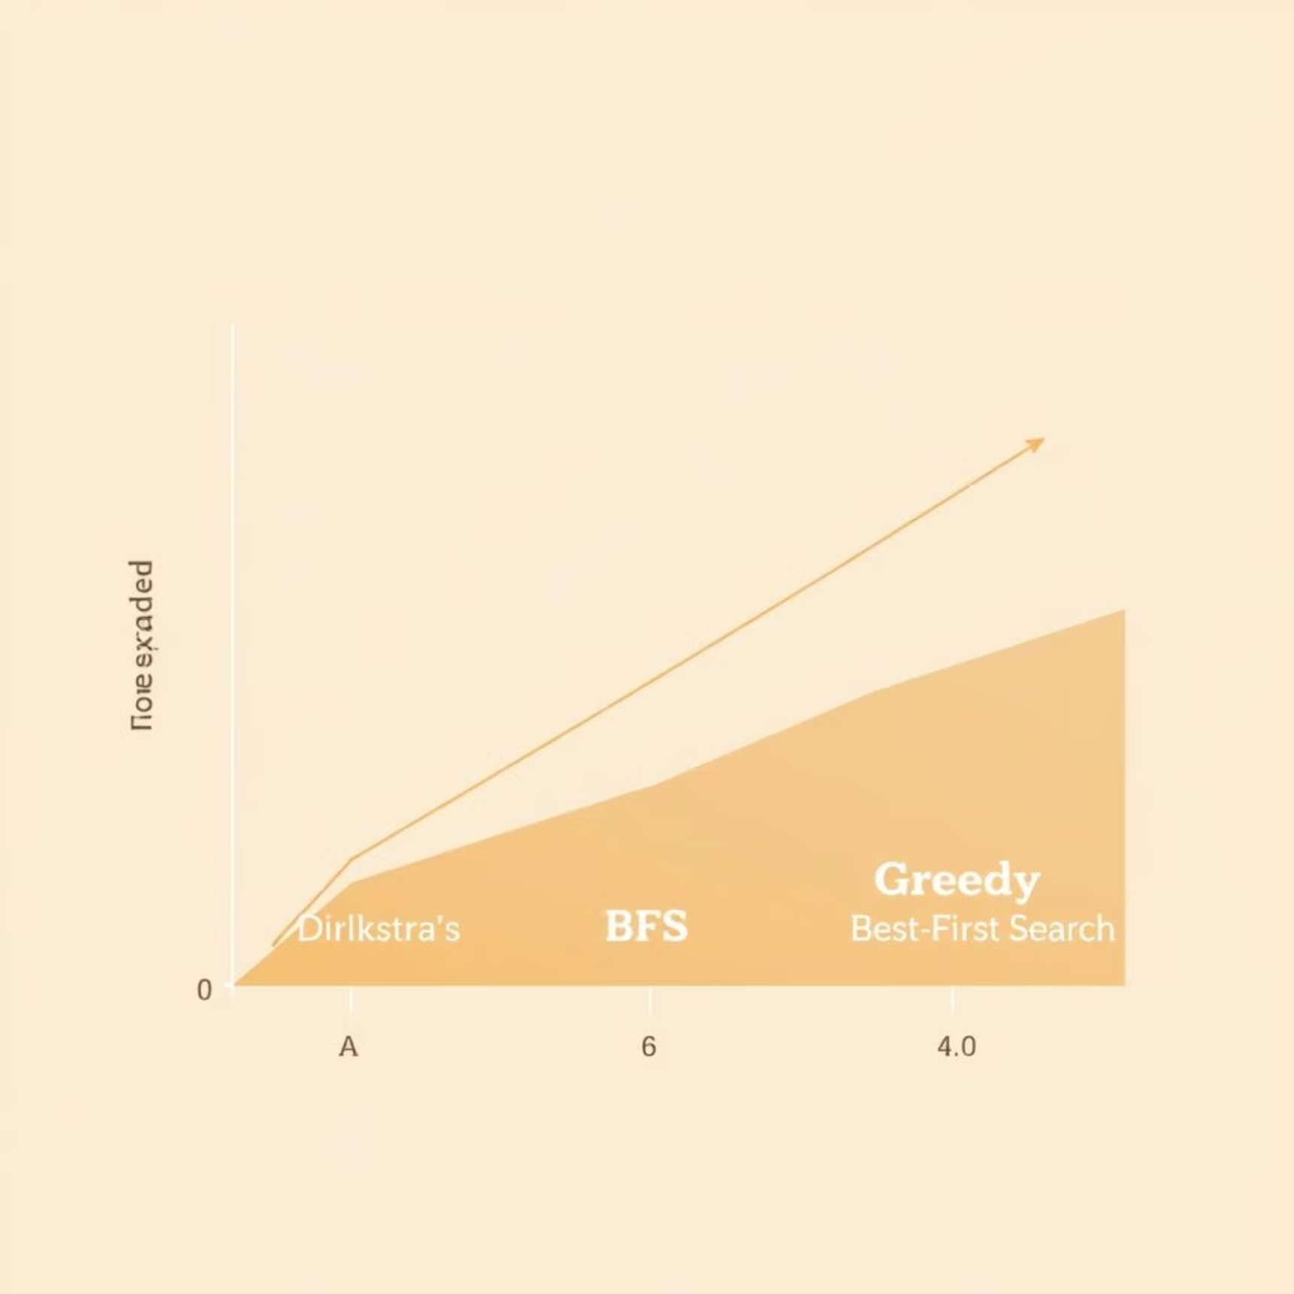

The A* Search Algorithm
A* Search is the most widely known and used informed search algorithm. It combines the cost-to-reach from the start node, $g(n)$, with the heuristic cost-to-go, $h(n)$, using the evaluation function $f(n) = g(n) + h(n)$.
Understanding the A* Evaluation Function
The core of A* lies in its evaluation function $f(n) = g(n) + h(n)$, which estimates the total cost of the path through node n to the goal. This balance ensures both efficiency and optimality.
Optimal Performance
A0* Algorithm
A* is complete and optimal if the heuristic is admissible (for tree search) or consistent (for graph search).
A variation designed for AND-OR graphs, useful for problems that can be decomposed into subproblems.
Admissibility
For A* to be optimally efficient, the heuristic $h(n)$ must be admissible. This means $h(n)$ never overestimates the true cost to reach the goal.
Consistency
A heuristic $h(n)$ is consistent if for every node $n$ and any successor $n'$ of $n$, the estimated cost $h(n)$ is less than or equal to the actual cost to get from $n$ to $n'$ plus the estimated cost from $n'$ to the goal ($h(n) \le \text{cost}(n, n') + h(n')$).
A* Search Execution: Open and Closed Lists
During its execution, A* maintains two lists: the open list (nodes to be evaluated) and the closed list (nodes already evaluated). This process efficiently guides the search toward the goal.
Measuring Problem-Solving Performance
Performance is judged by three main factors:
Completeness: Does the algorithm guarantee finding a solution if one exists?
Optimality: Does it guarantee finding the best solution (lowest path cost)?
Time and Space Complexity: The resources required to execute the algorithm.
A* Performance vs. Other Algorithms
A* typically outperforms many other search algorithms due to its informed approach, balancing exploration and exploitation to find optimal paths more efficiently.
A* Pathfinding Example
Observe A* in action as it efficiently navigates a grid, step-by-step, to find the shortest path from a start point to a goal, prioritizing nodes with the lowest f(n) value.

Slide 9

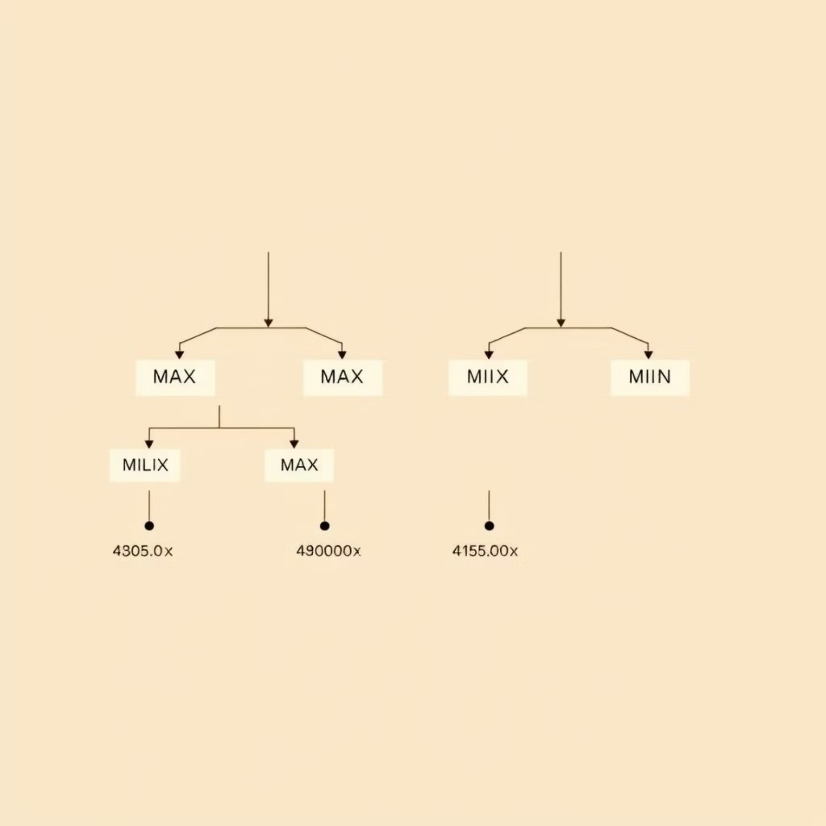

Minimax and Alpha-Beta Pruning for Games
For two-player, zero-sum games (e.g., Chess, Checkers), the Minimax Algorithm determines the optimal move by assuming the opponent plays optimally to minimize the agent's gain.
Minimax Principles
The maximizing player (MAX) chooses the move with the highest utility.
The minimizing player (MIN) chooses the move with the lowest utility.
The search evaluates entire game trees down to terminal states or a cutoff depth.
Alpha-Beta Pruning
This optimization dramatically improves Minimax by eliminating branches of the search tree that cannot possibly influence the final decision, without changing the result. It prunes:
Alpha (α): The highest value found so far for MAX.
Beta (β): The lowest value found so far for MIN.

Slide 10



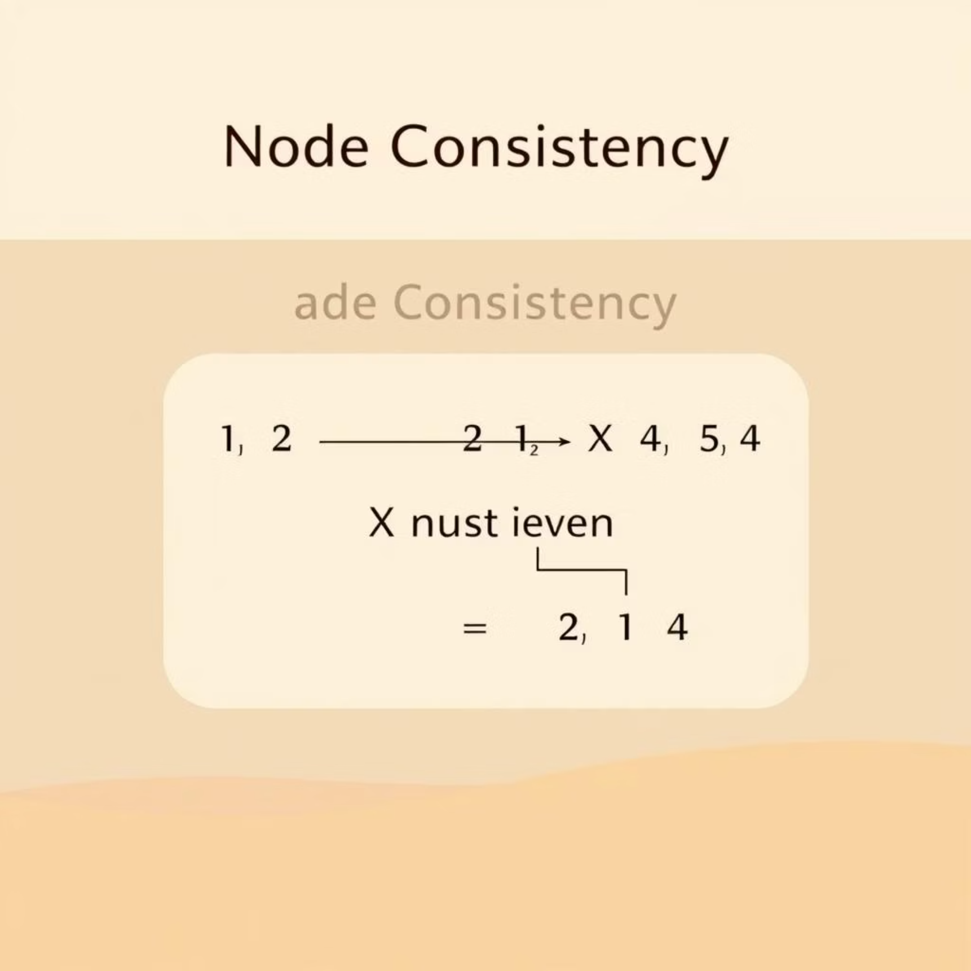

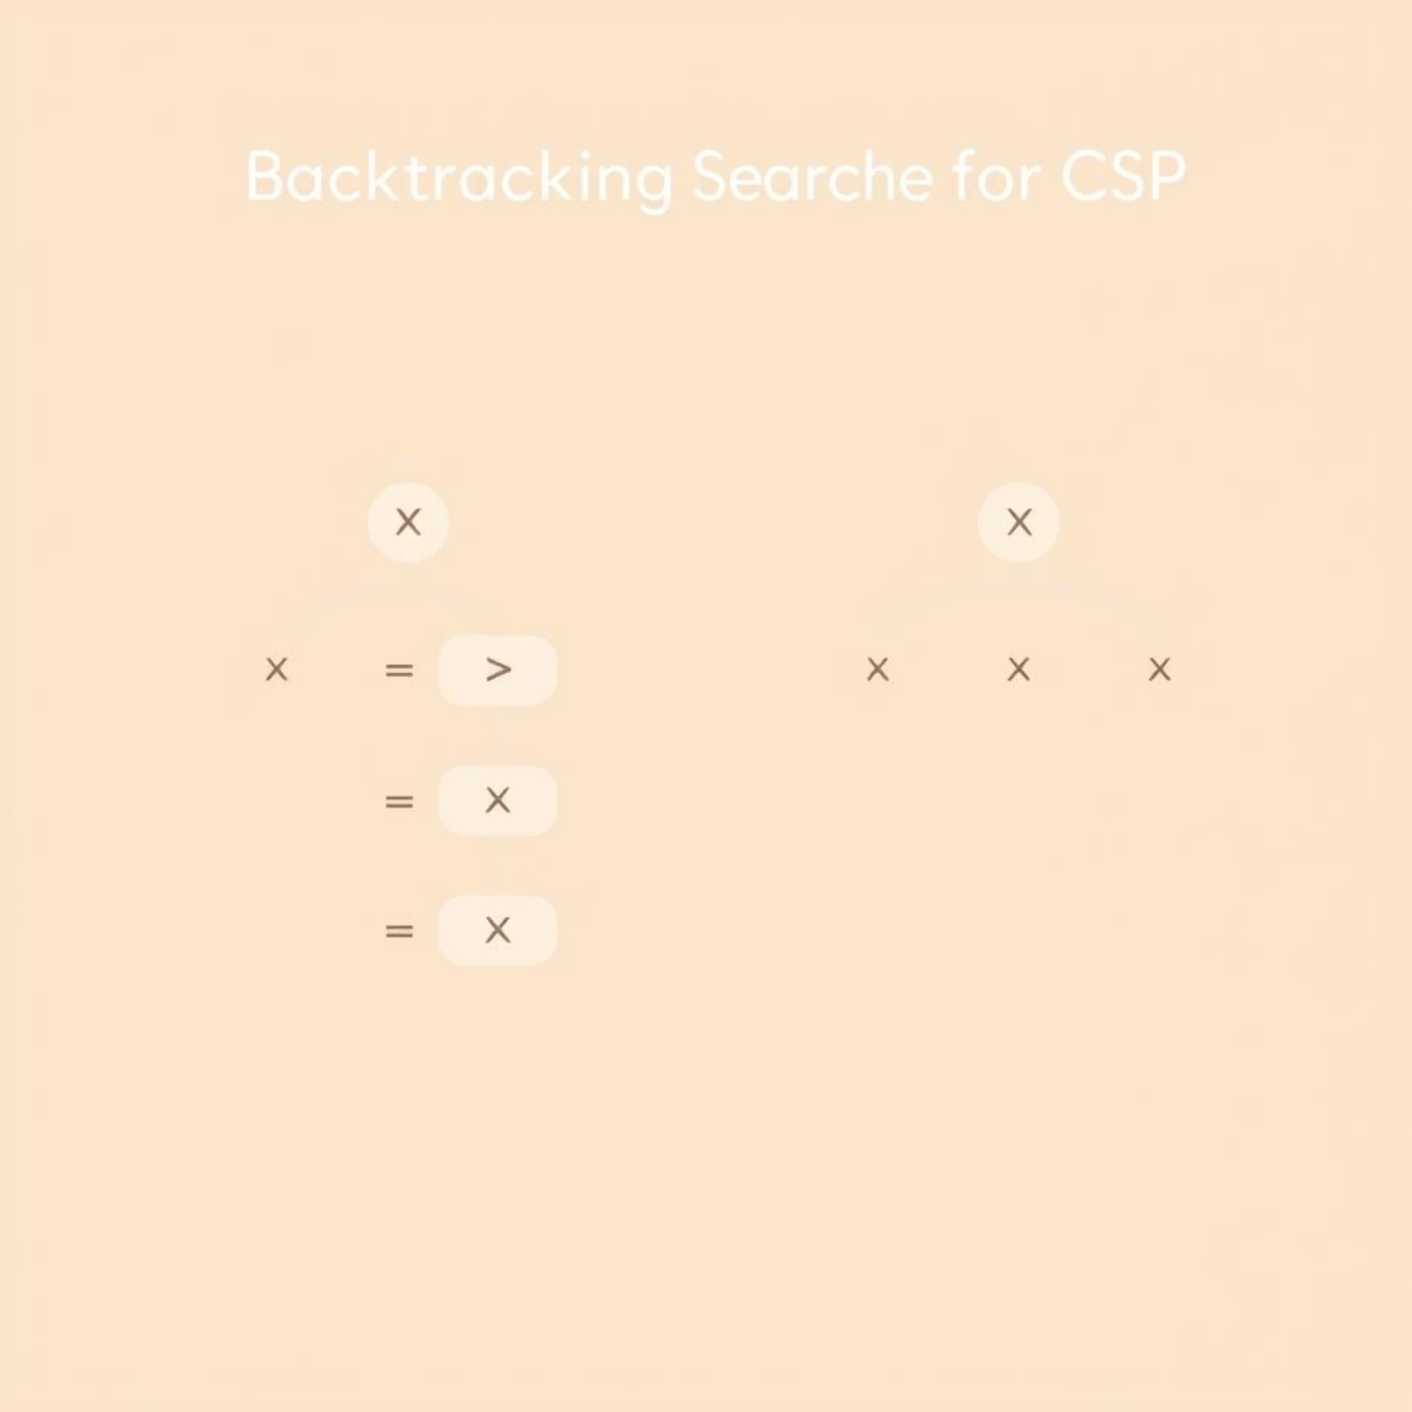
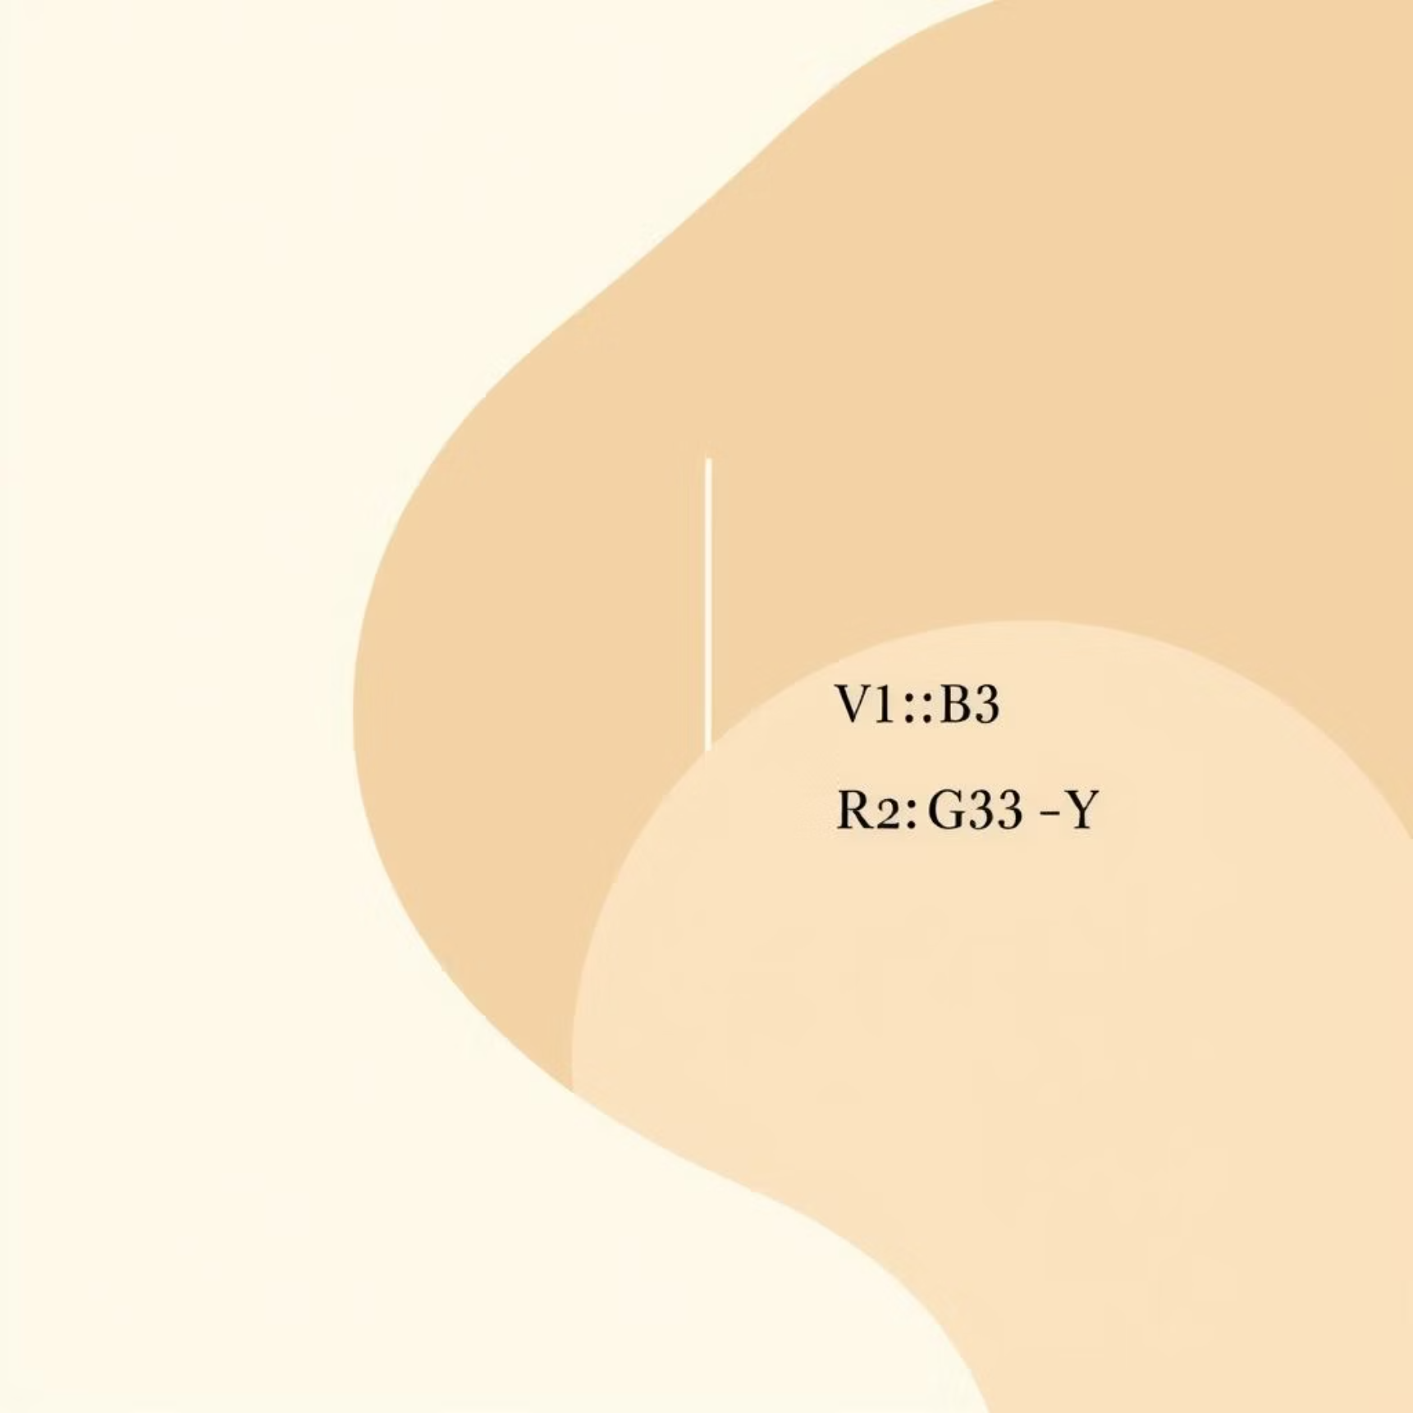


Part III: Constraint Satisfaction Problems (CSPs)
CSPs involve finding values for a set of variables that satisfy a given set of constraints. They are defined by three components: Variables, Domains, and Constraints.
Core Concepts
Problems like Map Coloring and the Cryptarithmetic Puzzle are standard CSP examples.
The Cryptarithmetic Puzzle challenges you to assign unique digits to letters, satisfying a mathematical equation. It exemplifies how CSPs can model letter-to-digit mappings with arithmetic constraints.
Local Consistency
Techniques like Node Consistency, Arc Consistency (AC-3), and Path Consistency are used to prune inconsistent values from domains before or during search, minimizing the search space.
Node Consistency ensures that every variable's domain satisfies all unary constraints. If a value in a domain violates a unary constraint, it is removed, simplifying the variable's possible assignments.
Path Consistency takes consistency a step further by considering triples of variables. It ensures that any consistent assignment of two variables can be extended to a third variable, further tightening the domains and reducing the search space.
Search and Heuristics
Backtracking Search is the basic algorithm. It is often enhanced with heuristics like MRV (Minimum Remaining Value) and the Degree Heuristic to choose which variable to assign next.
The Minimum Remaining Value (MRV) heuristic prioritizes assigning variables with the fewest legal values remaining in their domains. This strategy aims to detect failures earlier, reducing the overall search effort.
The Degree Heuristic selects the variable that is involved in the largest number of constraints with unassigned variables. This helps to reduce the branching factor for future assignments and can significantly reduce the search tree size.
Global Consistency and K-Consistency represent stronger forms of pruning, while Bound Propagation is a specialized technique used for interval domains.

